Slide 1
Welcome to St. Anthony’s Religious Education Classes 2021-2022!
This Year’s Theme:
OUR CHURCH IN THE WORLD
GOD GAVE US

Slide 2
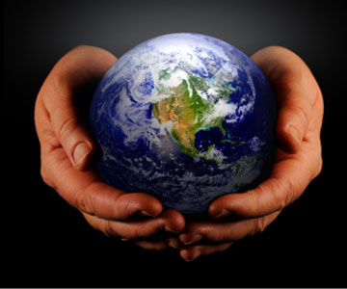
https://weleadworship.com/hes-got-the-whole-world-in-his-hands.html The Catholic Church helps all of humanity and the world God created. Here are two songs that will help us to start thinking about this theme: “He’s Got the Whole World in His Hands” and “What a Wonderful World.”
https://www.youtube.com/watch?v=kDBJNQiugnM
https://www.youtube.com/watch?v=Zu_0qITC6lI

Slide 3
The World God Gave Us
God the Father, the First Person of the Blessed Trinity, created the universe, including planet Earth and everything in it. This includes the land, the sea, the plants, the animals, and the people.

Slide 4
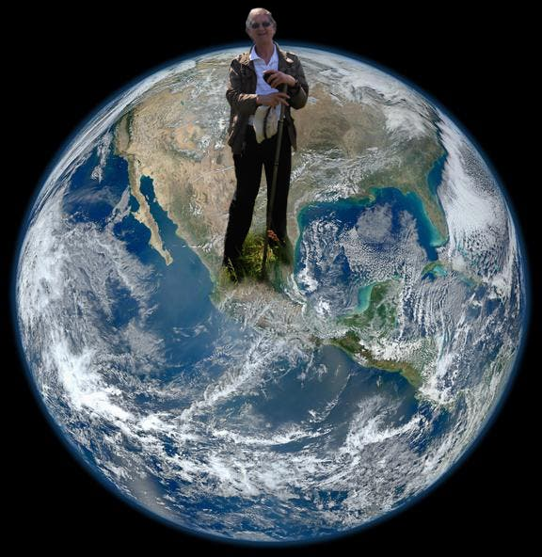
Our Responsibilities
God expects us to take care of what He created:
Psalm 115:16
“The heavens are the Lord's heavens, but the earth he has given to the children of man.”

Slide 5
The Catholic Church Catholic = Universal
Jesus, who is God the Son, the Second Person of the Blessed Trinity, came to Earth to bring Salvation to all. He sent His twelve apostles out to share the Word of the Gospel. Starting from the work of these twelve men and other disciples and those who followed, the Catholic Church eventually spread throughout the world. Today, the Pontifical Yearbook of the Vatican states that there were about 1.329 billion baptized Catholics at the end of 2018. https://en.wikipedia.org/wiki/Catholic_Church_by_country
One of the aspects of our Church that we will study this year is how these followers of Jesus traveled to preach the Word of Jesus and help set up the early churches. How they did this is recorded for us in The Acts of the Apostles, which is part of the New Testament.

Slide 6
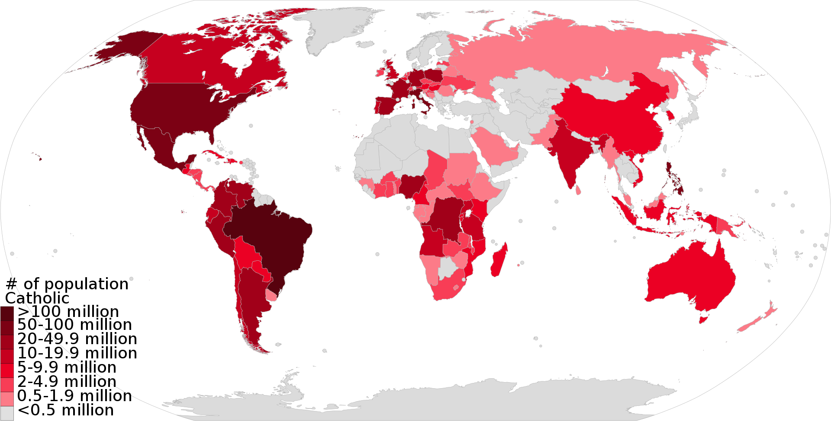
Number of Catholics Around the World Today

Slide 7
The Catholic Church in the World
The Catholic Church does an enormous amount of work to take care of the people of the Earth:
“The Catholic Church is the ‘world's oldest continuously functioning international institution.’ It is also the largest non-government provider of education and health care in the world.” The Vatican oversees the Catholic Church’s vast international network of charities.
https://en.wikipedia.org/wiki/Catholic_charities
Many people know that the Catholic Church has charities which help the poor, refugees, and other people in need of help. However, not everyone knows that the Catholic Church also has charities that help the environment. One of these is the Catholic Climate Covenant.

Slide 8
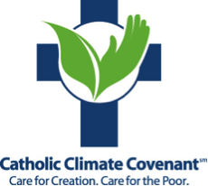
“Catholic Climate Covenant inspires and equips people and institutions to care for creation and care for the poor. Through our 19 national partners, we guide the U.S. Church's response to climate change by educating, giving public witness, and offering resources.” https://catholicclimatecovenant.org/

Slide 9
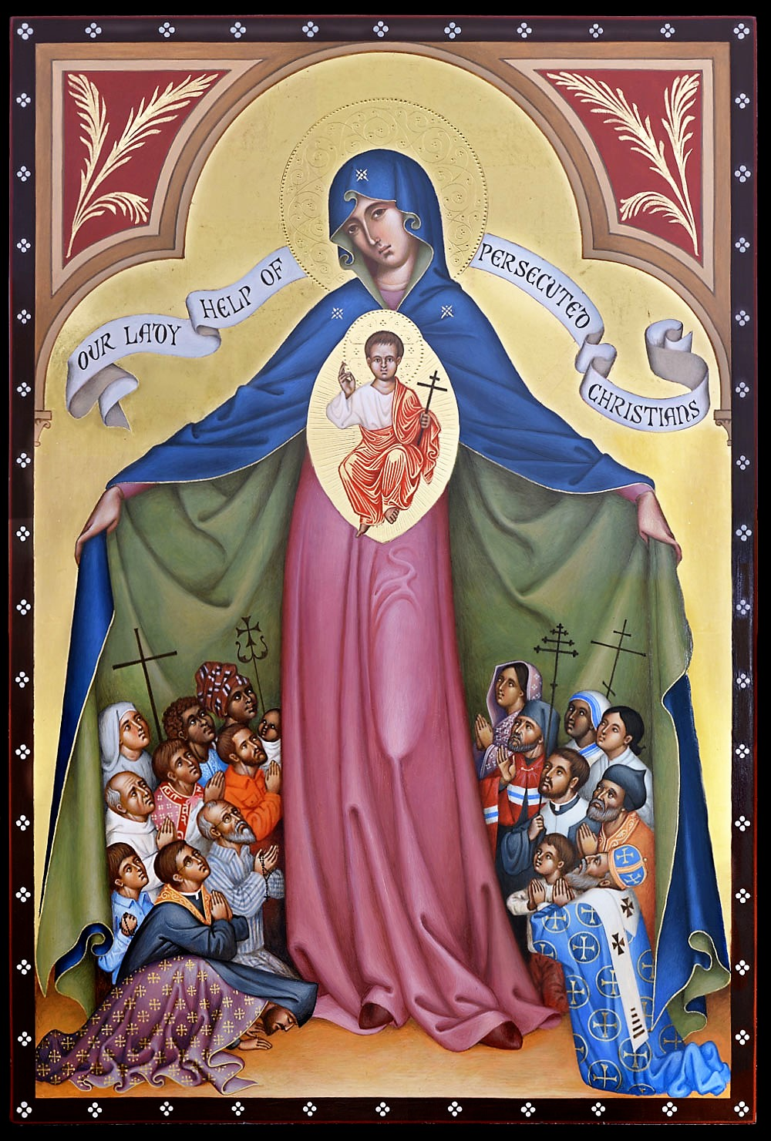
Catholics Around the World
This year we will learn about the lives of Catholics around the world. They have rich traditions.
Some Catholics and other Christians around the world can worship freely. Others do not have freedom of religion and are persecuted for their faith.
We will learn about how people can help them.
Our Lady of Persecuted Christians
https://www.omvusa.org/st-francis-chapel/our-lady-help-of-persecuted-christians-icon/

Slide 10
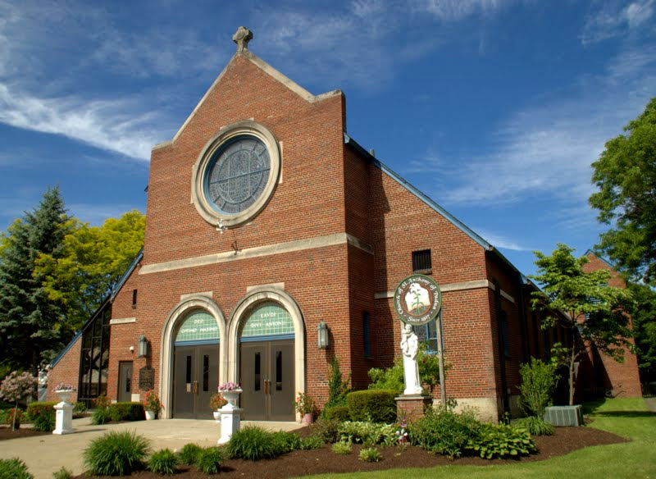
We are a part of the Catholic Church.
As Catholics, each of us in an important part of the Catholic Church. This year, in addition to our studies of the Word of Jesus and His Church, we will be discussing what we can do to help the Catholic Church in its on-going efforts to care for the people of the Earth and the land they live on. We pray for the guidance of the Holy Spirit, Third Person of the Blessed Trinity.
Thank you all for being part of St. Anthony’s Religious Education. Let’s have a wonderful year learning about our Catholic faith and how to be part of its efforts to help people and the world!

